Slide 1
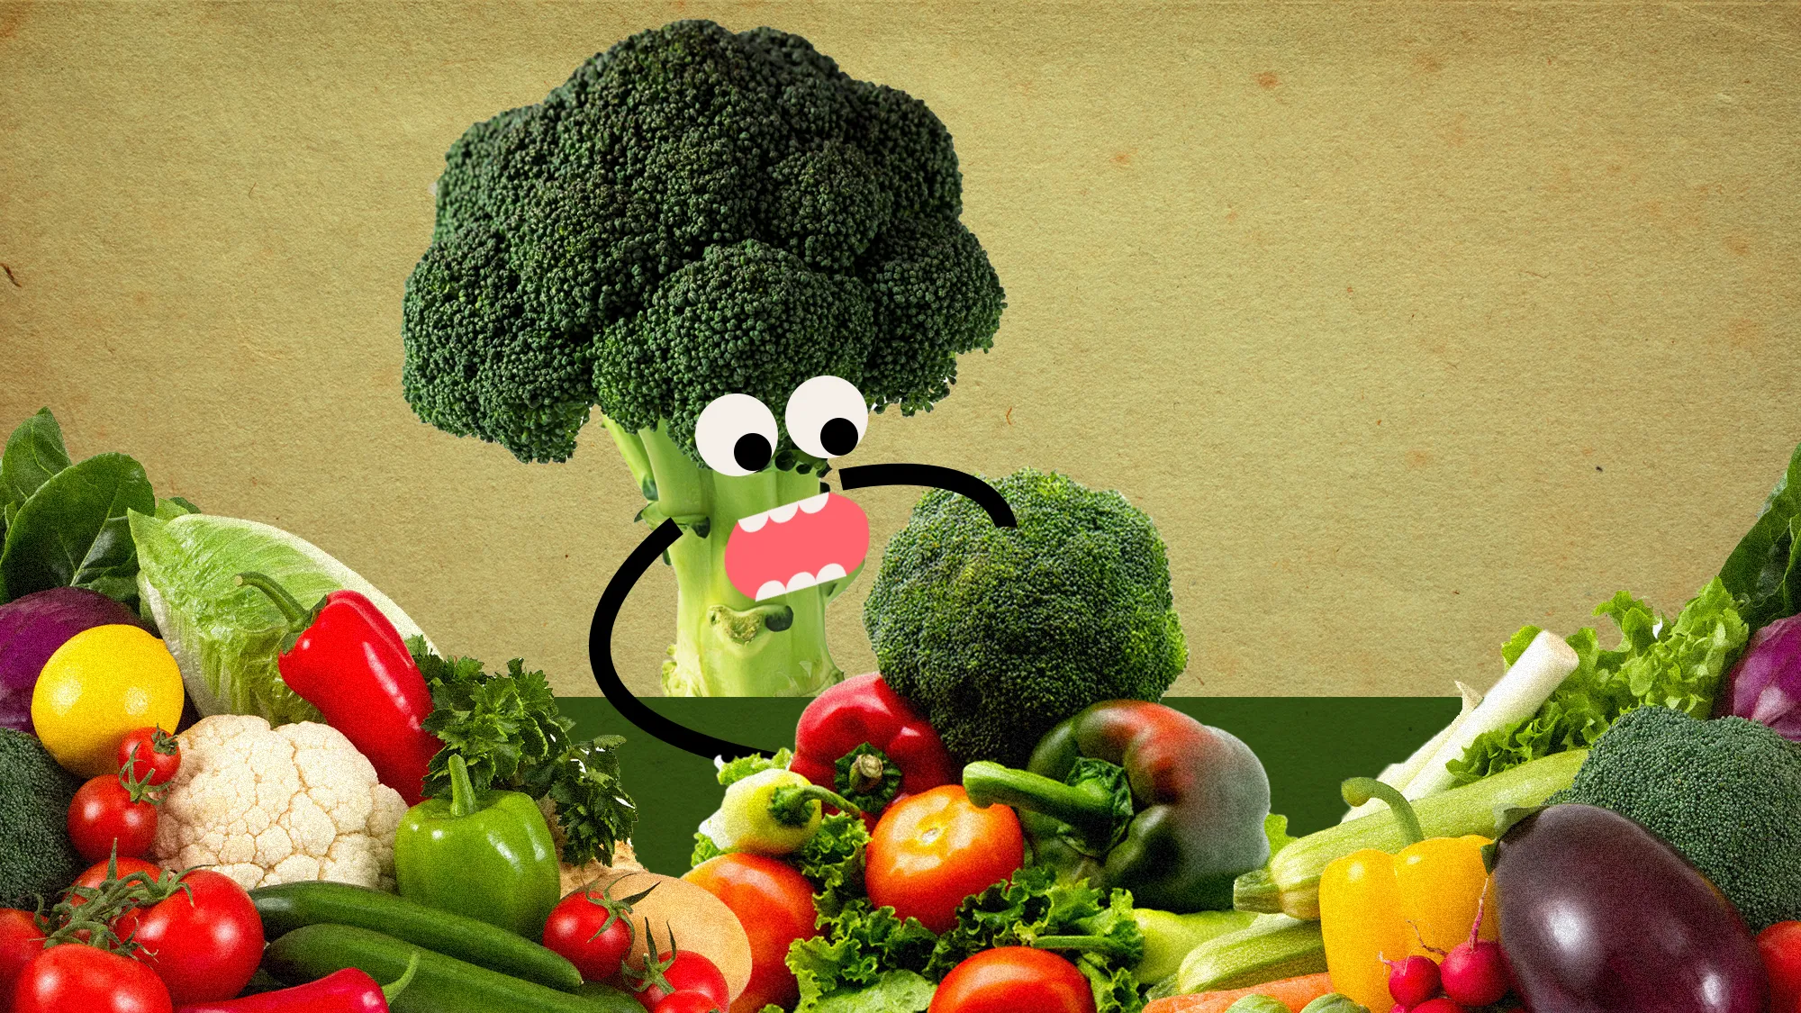
What The Veggie
Matheus Freire

Slide 2
INTRODUCTION
We've got an awesome app to tackle the food waste problem and ignite your culinary creativity! It's super user-friendly and perfect for managing household food waste. The coolest part? It generates ten random recipes based on what's in your fridge! Just snap a pic of a veggie, and voila, you'll have a bunch of delicious recipes using that ingredient. The app provides step-by-step instructions and ingredient lists. It's all about reducing waste, living sustainably, and getting closer to the food we eat. Let's join forces on this journey towards mindful and tasty cooking—one veggie at a time!

Slide 3
Food waste
In 2020, the first year of the Covid-19 pandemic, approximately 3 779
kg of food per person was wasted in the EU. Families accounted for 55% of the food waste, equivalent to 70 kg per person. The remaining 45% was waste generated within the food supply chain.
It is estimated that 184 kilograms (kg) of food per person were wasted in Portugal in 2020. Portugal ranks as the fourth highest country in the European Union (EU) in terms of food waste per person in 2020, trailing only behind Cyprus (397 kg), Denmark (221 kg), and Greece (191 kg).
Source - https://ec.europa.eu/eurostat/databrowser/view/env_wasfw/default/bar?lang=en

Slide 4
PROBLEMS
Accurate model creation: Developing a model that accurately recognizes various vegetables from pictures requires a large dataset and careful training.
Tight timeframe: The app needs to be developed within a short timeframe, which adds pressure to the development process.
Finding the right API: Identifying an API that provides access to a diverse recipe database, allowing for easy retrieval of relevant recipes based on the recognized vegetables, is crucial but requires careful evaluation.
Limited database of vegetables

Slide 5
Not convinced yet?
Don’t Know what to do with that old veggie you got in the fridge? We've got your back, Jack!
Say goodbye to mystery fridge items and hello to culinary delight!
Don't be a veggie hoarder, be a veggie explorer!
Snap a pic of that forgotten vegetable; we'll make it your kitchen hero!
No need to be a master chef, just let our app do its work and your friends and family will think you turned into Gordon Ramsey!
And best of all, it’s free.

Slide 6
HOW DOES IT WORK
STEP 1
STEP 3
Your image is processed in our state of the art CNN (convolutional neural network ) model, trained with 15 thousand plus images to make sure we get the right veggie
Our API will retrieve 10 random recipes for you in a matter of seconds
STEP 2
STEP 4
Once we are confident of what sexy veggie you gave us ,we send it to our API
Choose your recipe and make those veggies shine, you crazy diamond

Slide 7
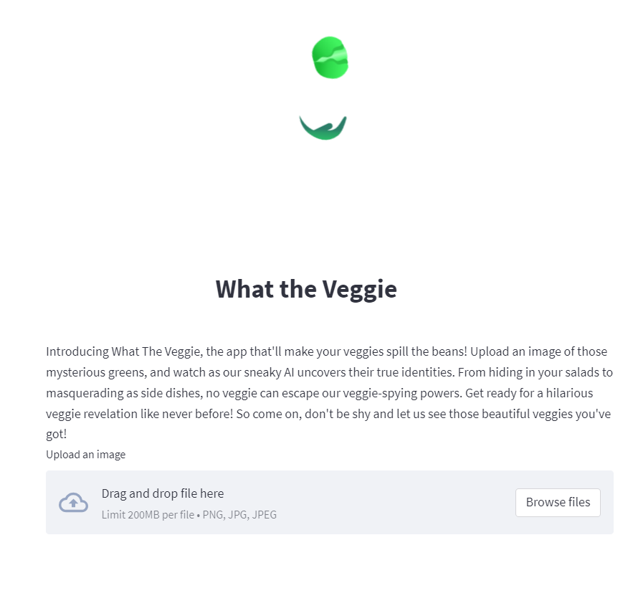
Upload your picture in our app
And voilà, ten delicious recipes will pop up

Slide 8
LET’S SEE IT IN ACTION

Slide 9
FUTURE
Database expansion: Increase ingredient database for a wider recipe selection.
Mobile app development: Create a mobile app version for enhanced accessibility.
Enhanced filtering options: Add more filters for users, including dietary restrictions, allergies, cuisine types, etc.
Video demonstration step by step on how to make the dish

Slide 10
THANK YOU
And common , don’t be shy, let us see your veggies!
https://www.linkedin.com/in/matheus-freire-08464a95/
Does anyone have any questions?

